Slide 1
CSE 495B (Natural Language Processing) Lecture 7
Self Attention Intro

Slide 2
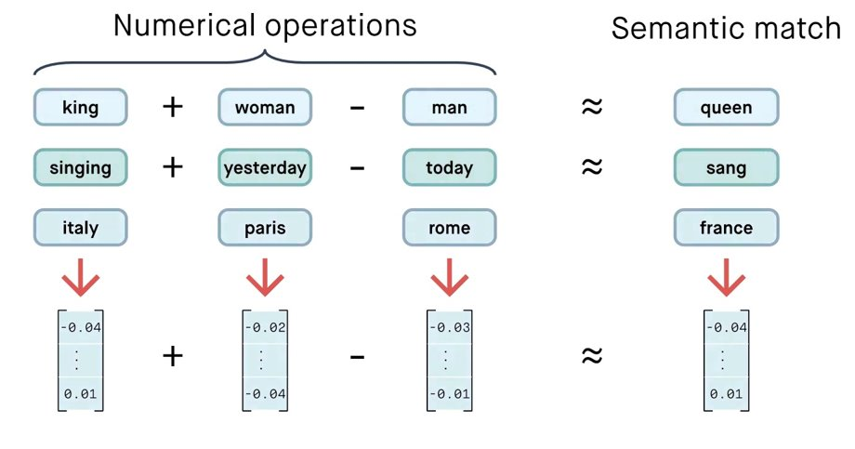
Word Embedding

Slide 3
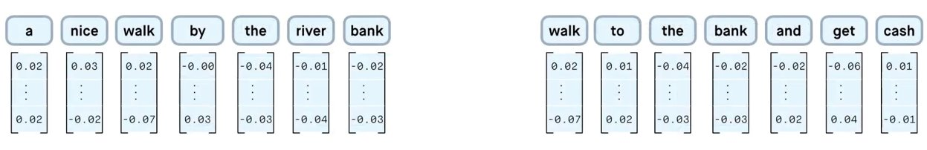
Embedding is Fixed

Slide 4
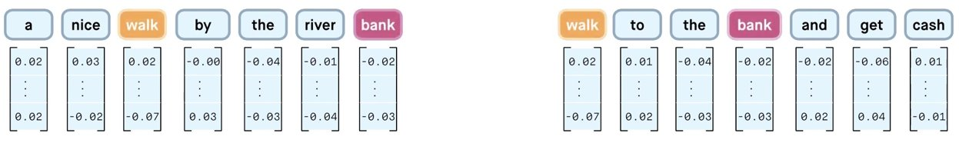
Embedding is Fixed

Slide 5
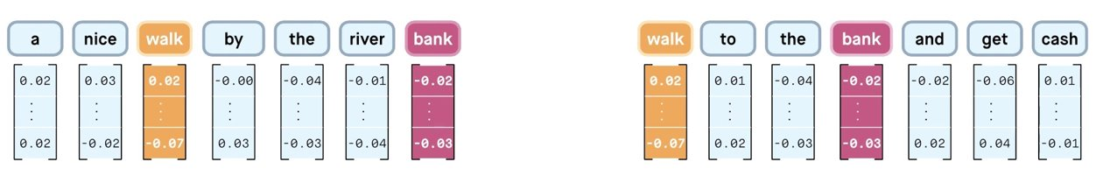
Embedding is Fixed

Slide 6
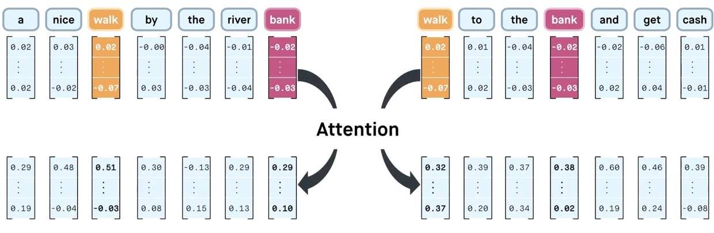
Attention adds more Context

Slide 7
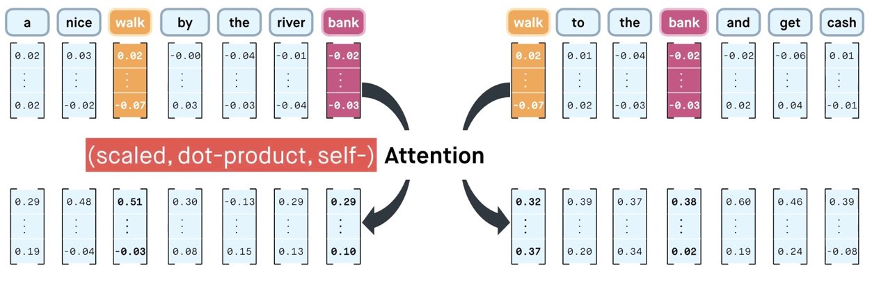
Attention adds more Context

Slide 8
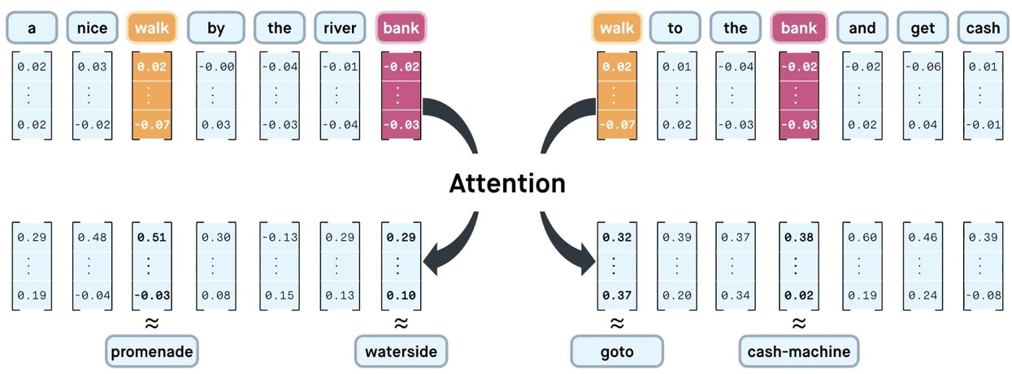
Attention adds more Context

Slide 9
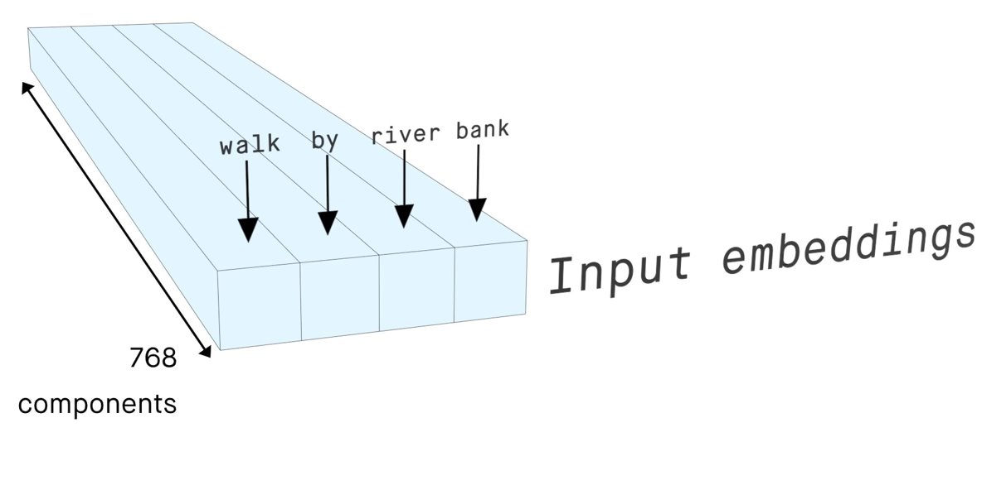
Self Attention Illustration

Slide 10
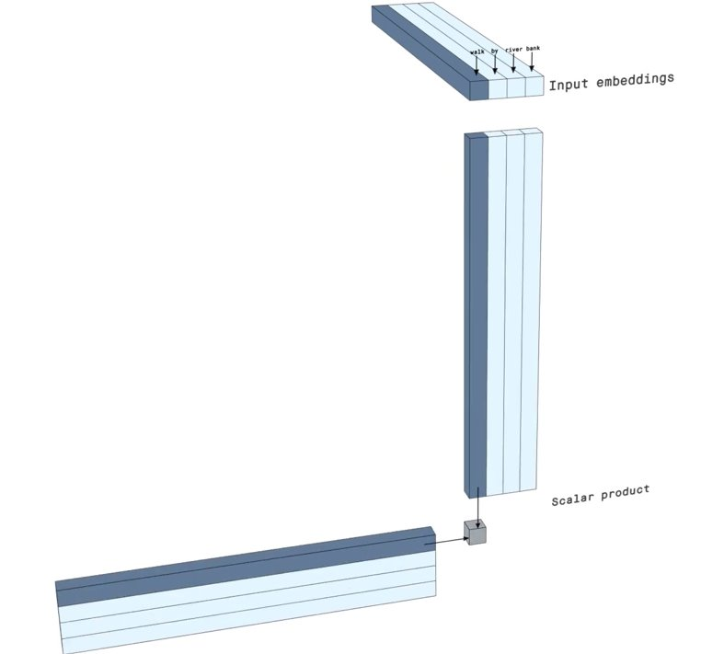
Self Attention Illustration

Slide 11
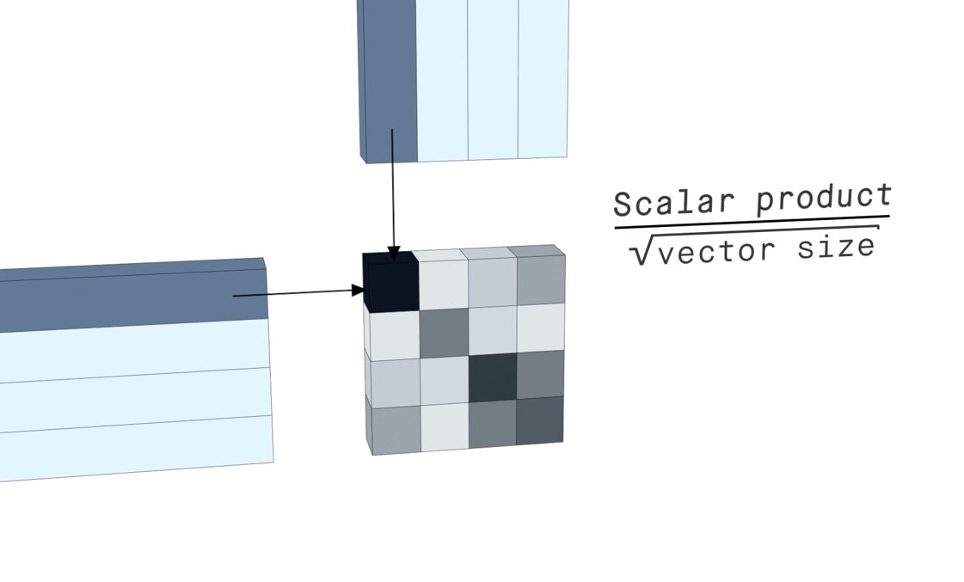
Self Attention Illustration

Slide 12
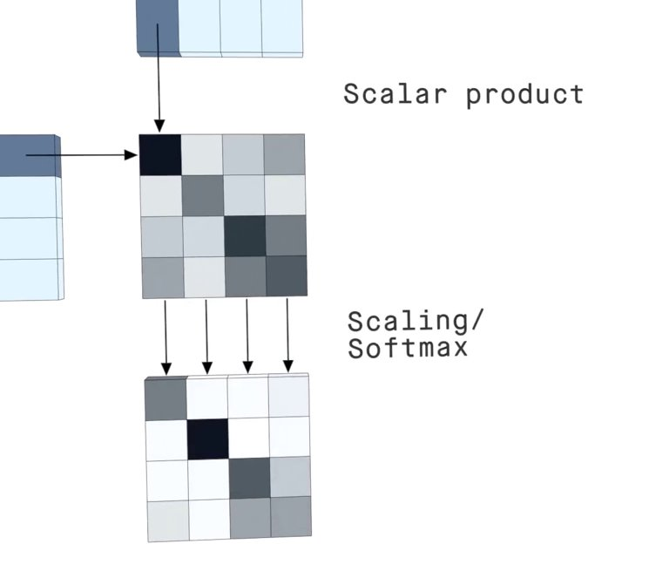
Self Attention Illustration

Slide 13
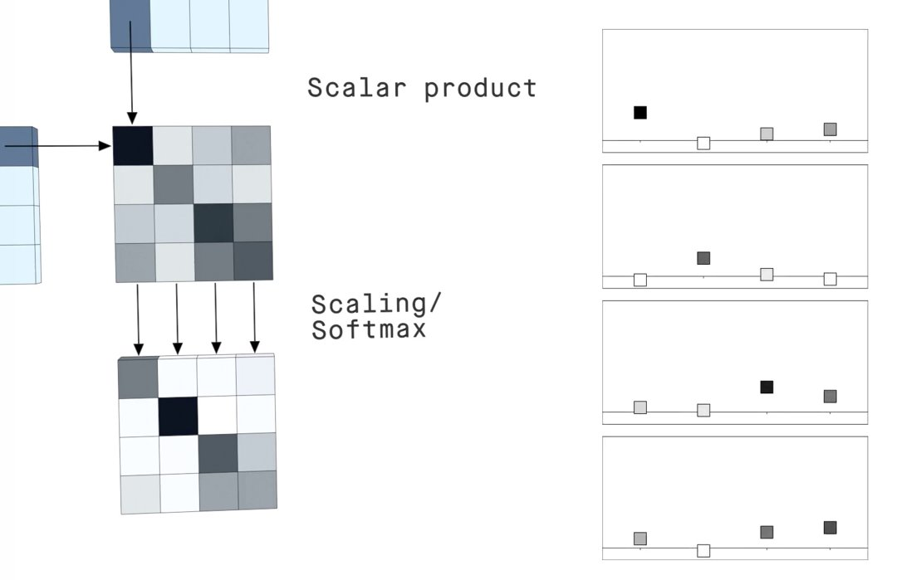
Self Attention Illustration

Slide 14
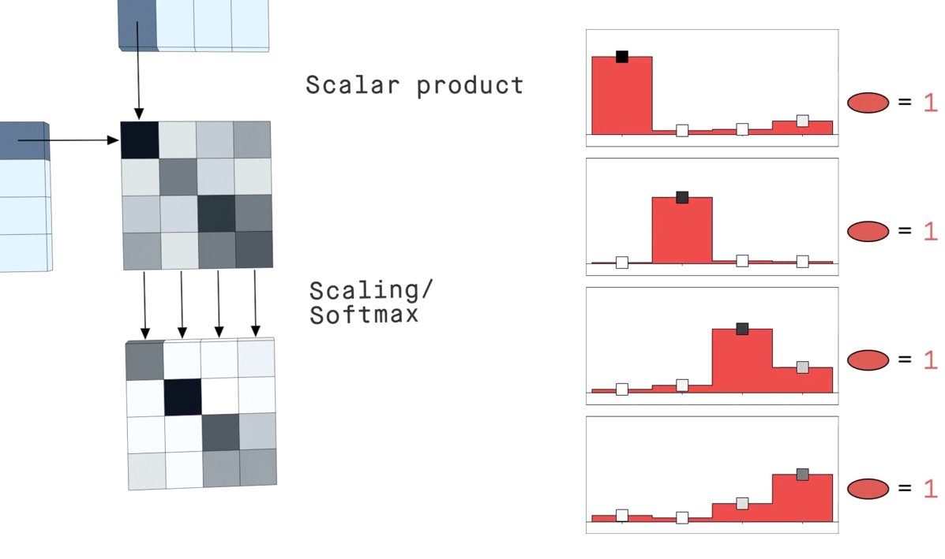
Self Attention Illustration

Slide 15
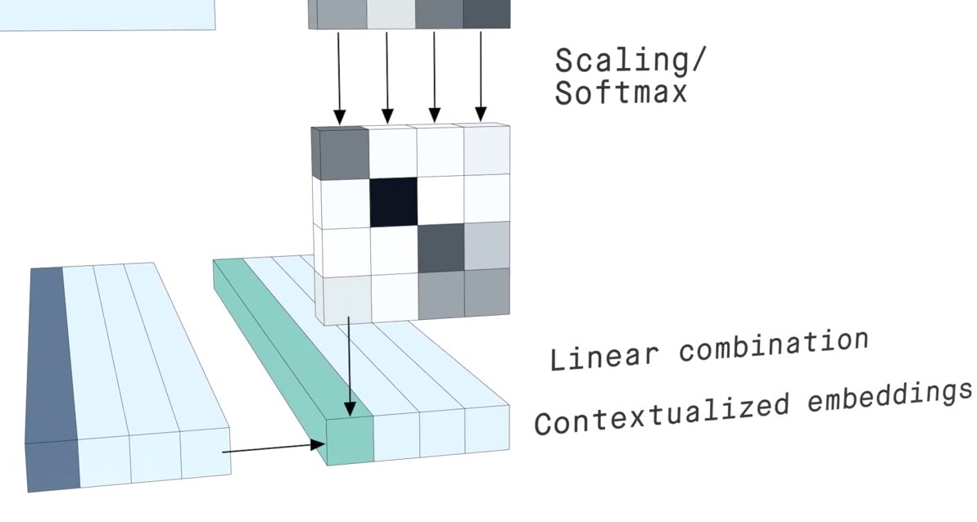
Self Attention Illustration

Slide 16
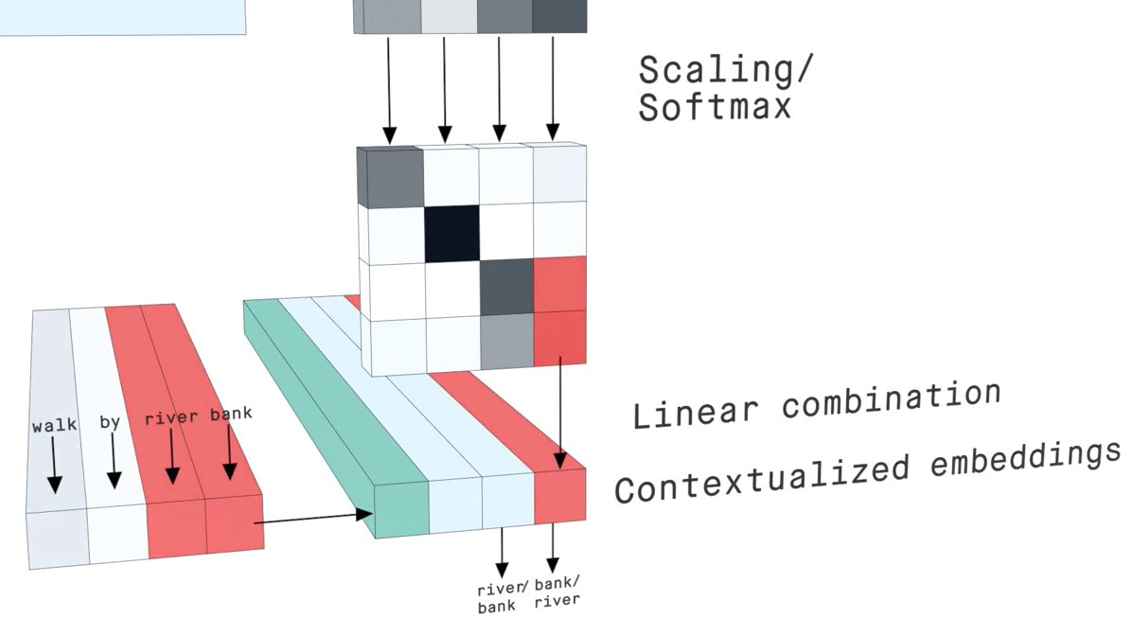
Self Attention Illustration

Slide 17
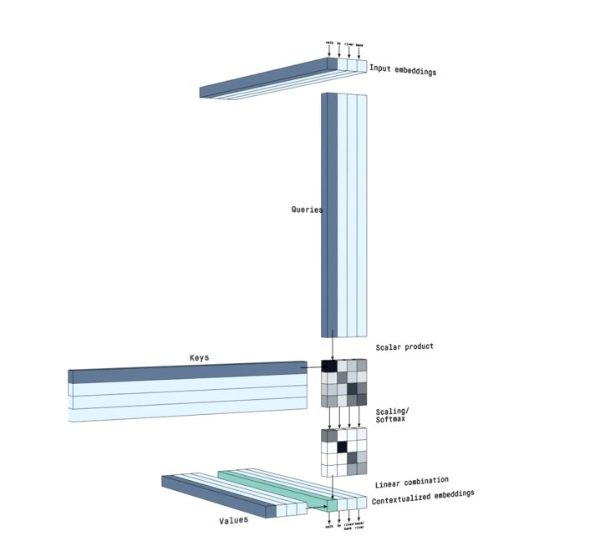
Self Attention Illustration

Slide 18
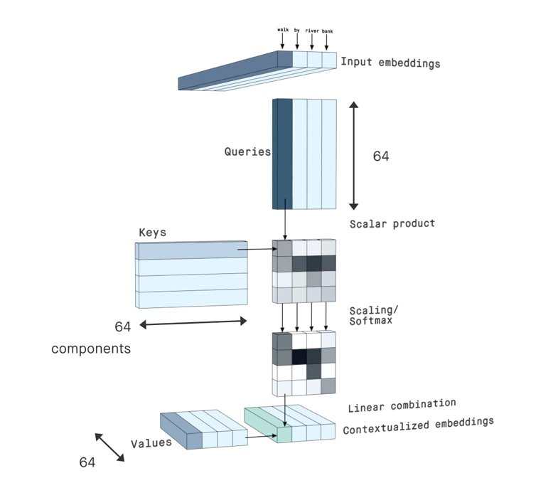
Self Attention Illustration

Slide 19
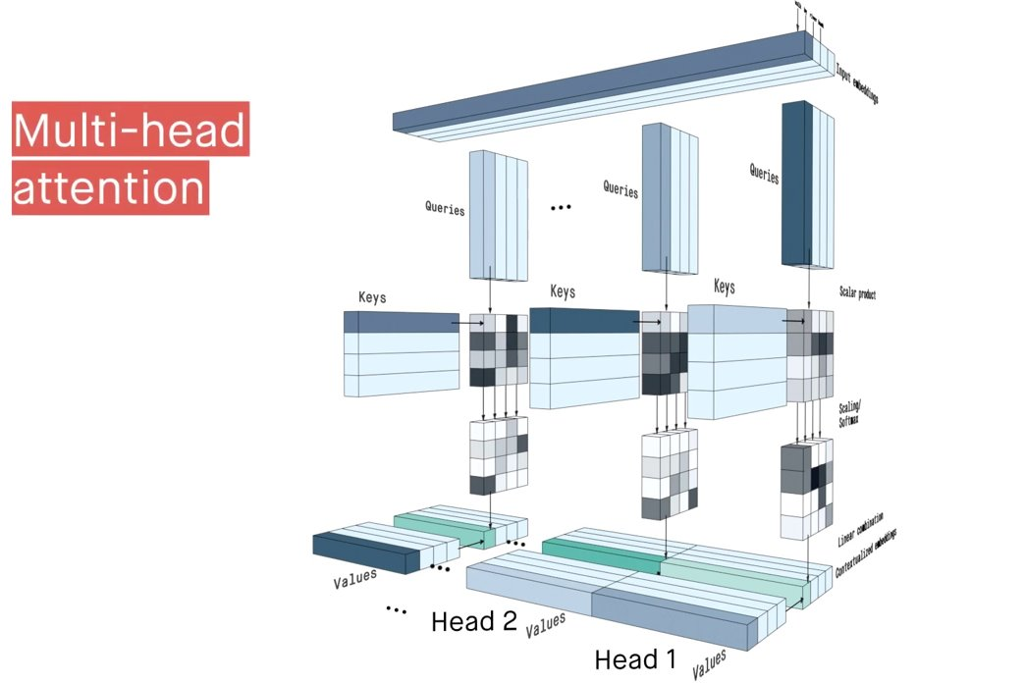
Self Attention Illustration

Slide 20
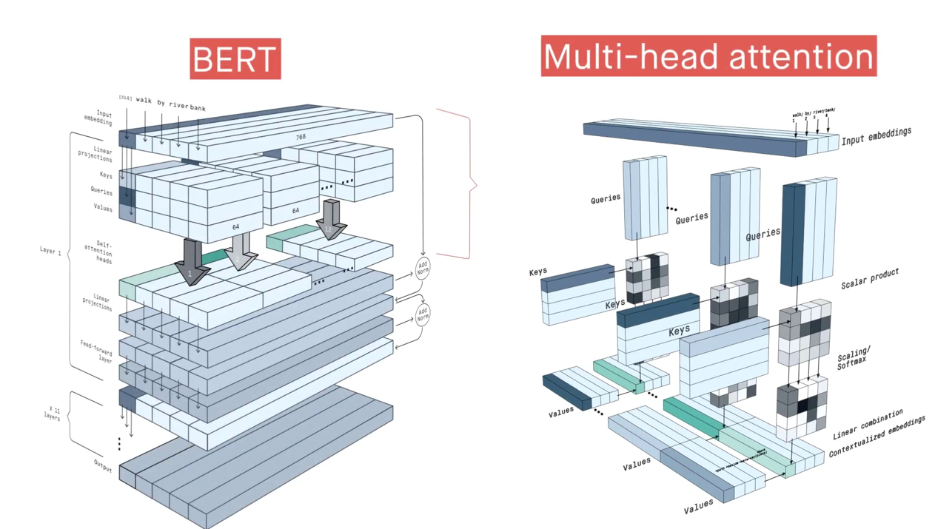
Self Attention Illustration

